Slide 1

CYBER BULLYING
CAUSES,PSYCHOLOGICAL EFFECTS & REDRESSAL

Slide 2

Group-5
IRTIZA AHSAN ABIR (21-45009-2)
ADIL AHMED SHAMIM (21-45190-2)
MD.ABDULLAH MAMON(21-45296-2)
HABIBULLAH S M (19-40309-1)
Supervised By : Mehedi Hasan

Slide 3
TABLE OF CONTENTS
01
02
03
04
PURPOSE OF REPORT
METHODOLOGY
FINDINGS & DISCUSSION
RECOMMENDATIONS

Slide 4
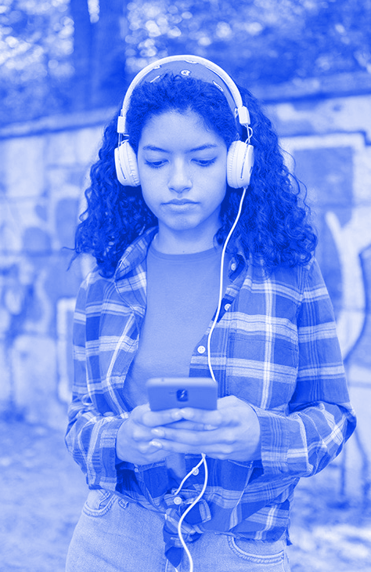
INTRODUCTION
The purpose of this report is to analyze the causes of cyberbullying , Psychological Effects & Redressal. Cyberbullying is bullying with the use of digital technologies. It can take place on social media, messaging platforms, gaming platforms and mobile phones. Cyberbullying is the term used to describe bullying that takes place online or through
text messaging.

Slide 5
OBJECTIVES
01
The objective of the research is why people are cyberbullied & for this reason what kind of mental pressures & bad effects they are facing.

Slide 6

SOME CAUSES & EFFECTS
Causes
Lack of parental supervision
Lack of knowledge about online behavior.
Social Pressure
Effects
Emotional Effects
Mental Effects
Behavioral Effects
Physical Effects

Slide 7
METHODOLOGY
In order to perform this study, we created a questionnaire and looked into how People face different issues by using the internet & other social medias.
For a 3 day period we ran our google form in social media to collect responses. We did not gather any personal data for this report. Public chose to participate , and it was anonymous.

Slide 8
DATA COLLECTION & EXEL ANALYSIS

Slide 9

FINDINGS
The findings will be presented in two sections according to the following characteristics: Effects of cyberbullying , Why people are cyberbullied.

Slide 10

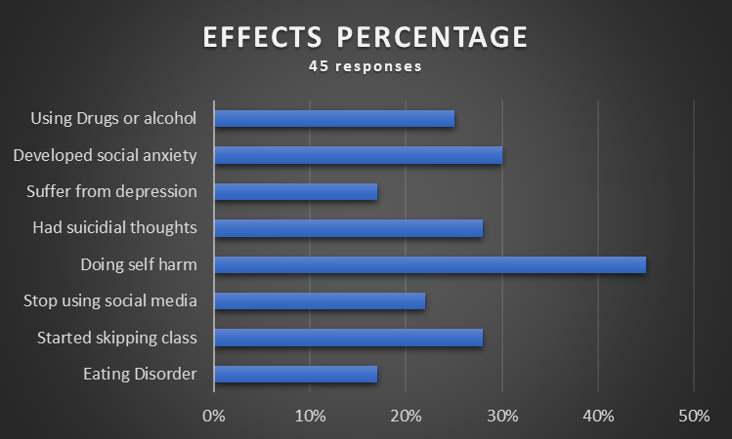
>Effects of using drugs or alcohol >Effects of social anxiety >Depression rate >Effects of suicidal thoughts >Effects of self-harm >Effects of stopping social media >Effects of starting to skip classes >Effects of eating disorders

Slide 11
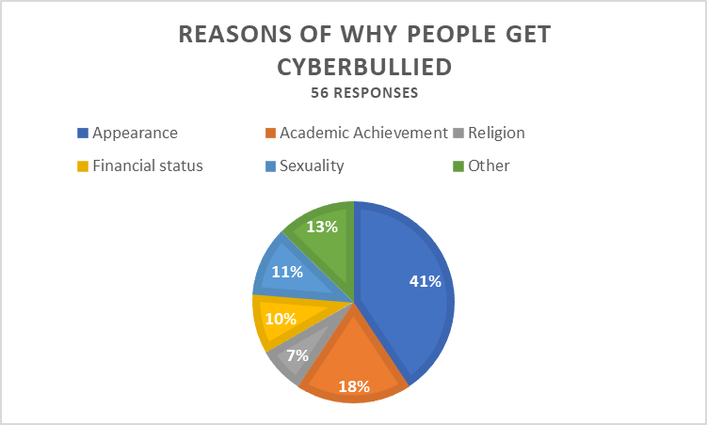
First factor is appearance
Academic success
Religion
Financial situation
Sexual orientation
Other factors

Slide 12
RECOMMENDATIONS
Online & Offline Method
To Inculcate Religious Values
Family Education
Proper Application Of The Law

Slide 13
CONCLUSION
Conclusion Cyberbullying has exposed itself as a new-fangled form of bullying within the last decade. It is become now an international public health concern among adolescents and so it needs continuous research.
There is need for defining and creating awareness about the prevention methods of cyberbullying through intervention techniques, cyberbullying therapy and laws.

Slide 14
—SOMEONE FAMOUS
THANKS!

